Slide 1
STATISTICAL ANALYSIS
Understanding Statistical Methods and Applications

Slide 2
What is Statistical Analysis?
Definition:
Statistical analysis involves collecting, examining, and interpreting data to identify patterns and make informed decisions.
Importance:
1. Data-Driven Decision Making:
Provides empirical evidence to support decisions, reducing reliance on intuition or guesswork.
2. Understanding Trends and Patterns:
Helps identify relationships within data, enabling organizations to recognize trends over time, understand consumer behavior, and improve strategies.
3. Risk Assessment and Management:
Allows for quantifying risks and uncertainties, helping businesses and researchers make informed decisions that account for potential risks.
4. Improving Operational Efficiency:
Identifies areas for improvement in processes and operations, leading to optimized resource allocation and increased productivity.

Slide 3
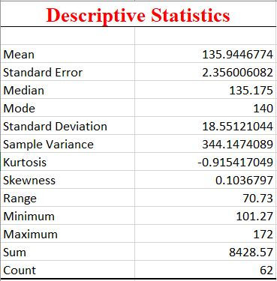
Descriptive Statistics
Summarizes data through measures of central tendency (mean, median, mode) and dispersion (range, variance, standard deviation).
Visual tools like histograms and box plots help illustrate key trends and patterns in the data.
Provides insights into the distribution's shape, including skewness and kurtosis, to understand data behavior.

Slide 4
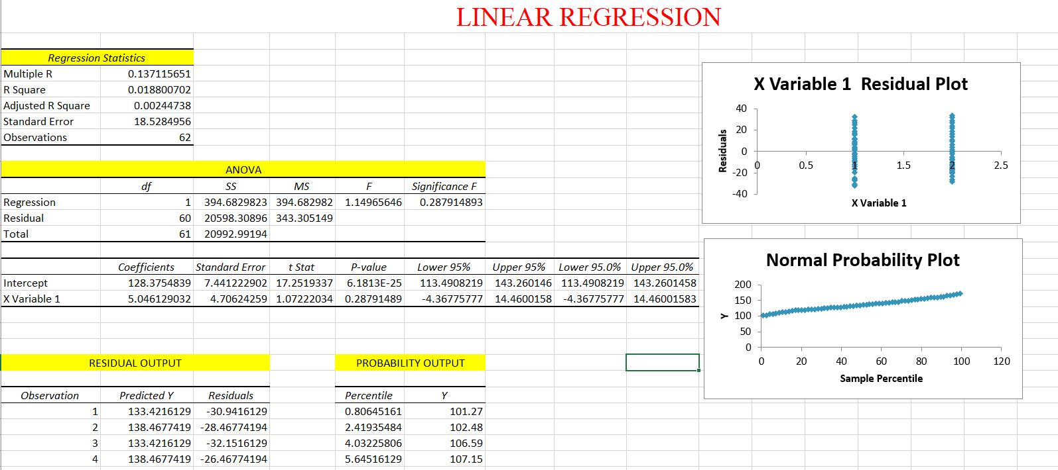
Linear Regression
A statistical method used to model the relationship between a dependent variable and one or more independent variables.
Provides an equation (e.g., Y=a+bXY = a + bXY=a+bX) that predicts the dependent variable based on the values of independent variables.
Assesses the strength of the relationship through metrics like R-squared, which indicates the proportion of variance explained by the model.
Useful for making predictions and guiding decision-making based on data trends.

Slide 5
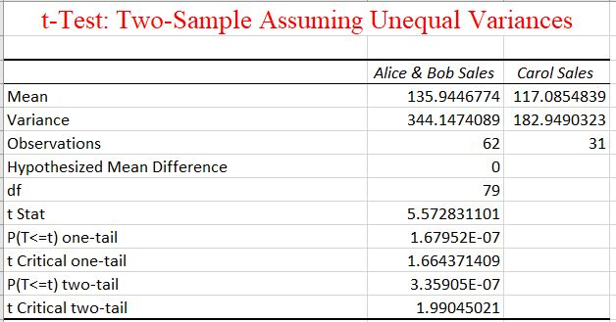
T-Test
A statistical method used to compare the means of two groups to determine if they are significantly different from each other.
Types include independent samples t-test (for comparing two separate groups) and paired samples t-test (for comparing related groups).
Results are assessed using the t-statistic and p-value, where a low p-value indicates a significant difference between group means.
Commonly used in hypothesis testing to support or reject assumptions about population parameters.

Slide 6
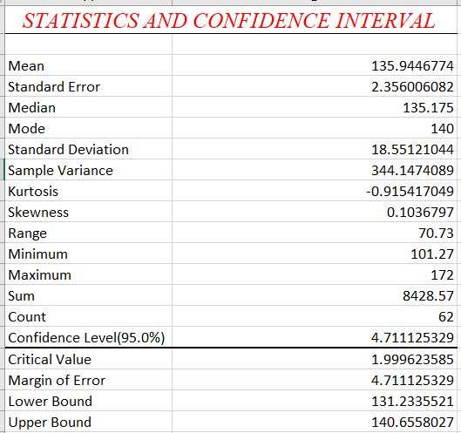
Confidence Intervals
A range of values derived from sample data that is likely to contain the true population parameter with a specified level of confidence (e.g., 95%).
Provides an estimate of uncertainty around the sample mean, helping to gauge the reliability of statistical estimates.
Widely used in hypothesis testing to assess the significance of results and inform decision-making based on the precision of estimates.
Helps communicate the variability in data and the potential range of outcomes to stakeholders.

Slide 7
Real-World Applications
1. Marketing:
- Analyse consumer behaviour and preferences through surveys and data analysis to optimize advertising strategies and target the right audience.
2. Manufacturing:
- Utilizes quality control metrics and process optimization techniques to improve product quality, reduce waste, and enhance operational efficiency.
3. Transportation:
- Assesses traffic patterns and transportation systems to improve logistics, optimize routes, and enhance safety measures.
4. Government:
- Uses statistical methods for census data analysis, policy evaluation, and resource allocation, helping to inform public policy and programs.
5. Environmental Science:
- Analyse data on climate change, pollution levels, and biodiversity to inform conservation efforts and environmental policy decisions.

Slide 8
In summary, statistical analysis is a vital tool across various fields, enabling data-driven decision-making and deeper insights into complex phenomena. By employing methods such as descriptive statistics, linear regression, t-tests, and confidence intervals, we can effectively summarize data, evaluate relationships, and assess uncertainties. The real-world applications—from business and healthcare to education and environmental science—demonstrate the power of statistics in enhancing understanding and guiding strategies. As we continue to generate and collect data, the importance of statistical literacy will only grow, empowering individuals and organizations to make informed choices based on evidence.

